Slide 1
Principal Component Regression (PCR)
Understanding and implementing PCR for handling multicollinearity in regression analysis

Slide 2
Contents
01
02
Multiple Linear Regression
Problem of Multicollinearity
03
04
Principal Component Analysis
Principal Component Regression
05
PCR in Python

Slide 3

Multiple Linear Regression: Statistical Model
Where,
      Y : Dependent Variable
      X₁, X₂ ,…, X_{p} : Independent Variables
      b₀, b₁ ,…, b_{p} : Parameters of Model
      e : Random Error Component
Independent variables can either be Continuous or Categorical

Slide 4
Problem of Multicollinearity
if there is a strong linear relationship among independent variables.
Multicollinearity exists
Highly Unstable Model Parameters
As standard errors of their estimates are inflated
Consequences
Model Fails to predict accurately out of sample Data
Multicollinearity is detected using Variance Inflation Factor, VIF
Tolerance = 1- R_{i}²
VIF = 1/Tolerance
where R_{i}² (R Squared) is obtained using regression of Xi on other independent variables
Any VIF > 5, indicates presence of multicollinearity

Slide 5
Multicollinearity – Remedial Measures
The problem of Multicollinearity can be solved by different approaches:
Drop one of the independent variables, which is explained by others
Use Principal Component Regression in case of severe Multicollinearity
Use Ridge Regression

Slide 6
Principal Component Regression
In Principal Component Regression,
Each Principal Component is a linear combination of all X variables
Final model is expressed in terms of original independent variables for ease of interpretation
First k principal components are used as independent variables instead of original X variables

Slide 7
Three-Step PCR Process
Transformation into Principal Components
The original p variables are transformed into a new set of orthogonal or uncorrelated variables called "Principal Components." These components capture the maximum variance in the data.
Regression Analysis
After elimination of the least important principal components, a multiple regression analysis of the response variable against the reduced set of principal components is performed using Ordinary Least Squares (OLS) estimation.
Back Transformation
The model equation is back-transformed in terms of original variables for interpretability. This step is optional in machine learning approaches but valuable for understanding variable relationships.

Slide 8
PCR-Statistical Model
Model in terms of original X variables:
Model in terms of Principal Components:

Slide 9
Case Study: Sales Prediction
Background
A company periodically records data for sales and expenses across 143 micro business zones. The company wishes to model the relationship between its sales and sales-related expenses to obtain accurate predictions.
Objective
Predict incremental sales based on planned sales-related expenses for strategic decision-making and resource allocation.
Available Information
Sample Size
Data available for 143 micro business zones
Dependent Variable
SALES — Incremental sales (target variable)
Predictors
Expenditure towards advertisements and promotions in current and previous months

Slide 10
Data Snapshot
SRNO | SALES | AD | PRO | SALEXP | ADPRE | PROPRE
1 | 20.11 | 1.98 | 0.9 | 0.31 | 2.02 | 0
2 | 15.1 | 1.94 | 0 | 0.3 | 1.99 | 1
3 | 18.68 | 2.2 | 0.8 | 0.35 | 1.93 | 0
4 | 16.05 | 2 | 0 | 0.35 | 2.2 | 0.8
5 | 21.3 | 1.69 | 1.3 | 0.3 | 2 | 0
6 | 17.85 | 1.74 | 0.3 | 0.32 | 1.69 | 1.3
7 | 18.89 | 2.07 | 1 | 0.31 | 1.74 | 0.3
8 | 21.27 | 1.02 | 1 | 0.4 | 2.07 | 1
9 | 20.48 | 2.02 | 0.9 | 0.45 | 1.02 | 1
10 | 20.54 | 1.06 | 1 | 0.45 | 2.02 | 0.9
11 | 26.18 | 1.43 | 1.5 | 0.5 | 1.06 | 1
12 | 21.72 | 1.88 | 0 | 0.6 | 1.46 | 1.5
13 | 28.7 | 2.27 | 0.8 | 0.65 | 1.88 | 0
14 | 25.84 | 1.11 | 1 | 0.65 | 2.27 | 0.8
15 | 29.32 | 1.77 | 1.2 | 0.65 | 1.11 | 1
16 | 24.22 | 0.96 | 1 | 0.65 | 1.77 | 1.2
17 | 26.59 | 1.99 | 1 | 0.62 | 0.96 | 1
18 | 22.24 | 1.97 | 0.1 | 0.6 | 1.99 | 1
Variable Descriptions
SALES: Incremental Sales (INR Million)
AD: Current Advertising Expenses
PRO: Current Promotional Expenses
SALEXP: Misc. Sales Expenses
ADPRE: Previous Period's Advertising
PROPRE: Previous Period's Promotions
All financial variables measured in INR Million with positive values only.

Slide 11
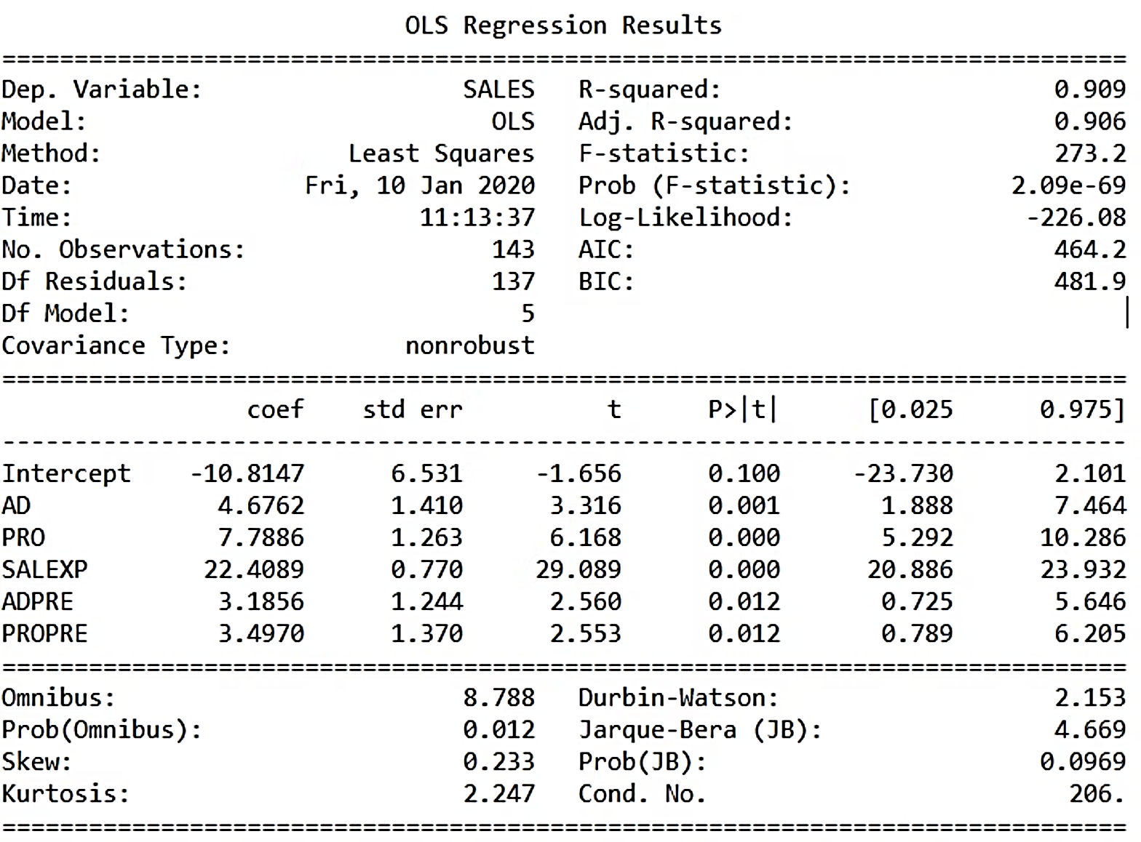
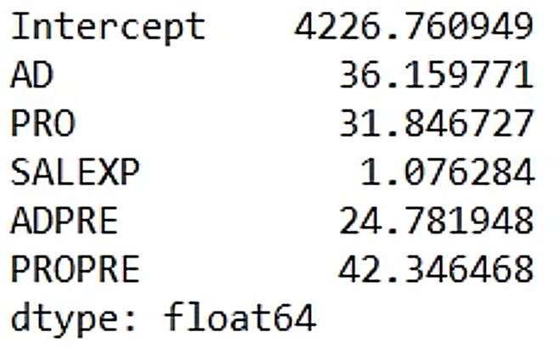
Linear Regression with Original Variables
Model Fit Results
Interpretation: Multiple R-Squared is 0.909, showing the model explains 91% of variance—apparently a good fit.
Multicollinearity Check (VIF)
Interpretation: VIF values are very high (>5, except for SALEXP), indicating severe multicollinearity. Despite good R², the model is unreliable for prediction.

Slide 12
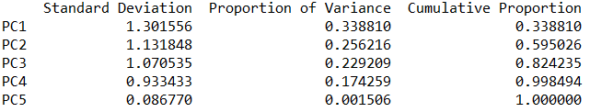
PCA to check number of components
# Output
Interpretation:
The first three principal components explain 82% of the variation in the data. Therefore, we will use 3 components in PCR

Slide 13
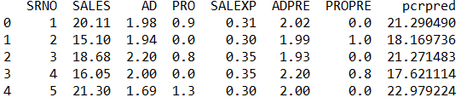
Predictions using PCR
# Output
pcrpred column gives the predicted values of SALES using PCR.

Slide 14
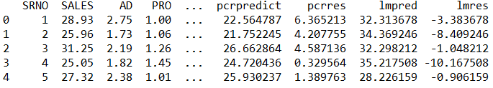
Comparing Linear Regression Model and PCR model on Test data
# Output
RMSE Using Linear Regression (OLS) : 9.112
RMSE Using PCR: 2.851
Interpretation:
RMSE using PCR is less than RMSE using linear regression, we may conclude that PCR model predicts SALES better than linear regression model when multicollinearity exists.

Slide 15
Key Takeaways
Multicollinearity Challenge
Highly correlated predictor variables violate regression assumptions and create unstable models—a frequent problem in real-world analytics that must be addressed.
PCR Solution
Principal Component Regression combines PCA with regression: transform to uncorrelated components, build the model, then back-transform for interpretation—effective for severe multicollinearity.
Python Implementation
Use pcr.nipalsPCR() function in the hoggorm library to perform PCR efficiently. The method produces more stable and accurate predictions than standard regression under multicollinearity.

